Slide 1
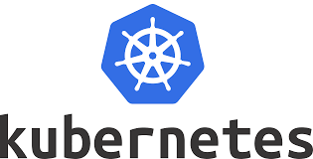

Kubernetes Presentation
Presented by- Prasad Yadav IT Infrastructure Admin

Slide 2
What is Kubernetes?
Kubernetes is a portable, extensible, open source platform for managing containerized workloads and services, that facilitates both declarative configuration and automation.
Kubernetes, at its basic level, is a system for running and coordinating containerized applications across a cluster of machines. It is a platform designed to completely manage the life cycle of containerized applications and services using methods that provide predictability, scalability, and high availability.
Kubernetes is an open source container deployment and management platform. It offers container orchestration, a container runtime, container-centric infrastructure orchestration, load balancing, self-healing mechanisms, and service discovery.

Slide 3
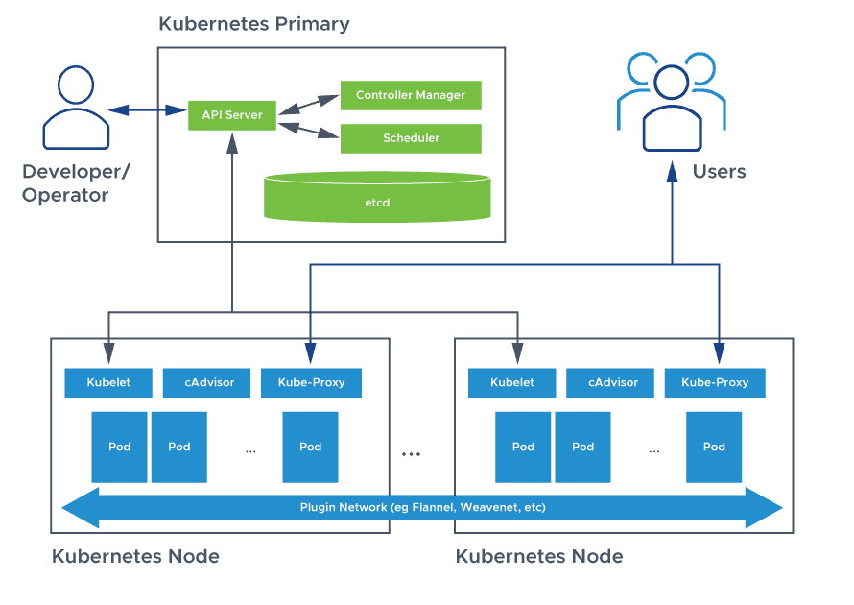
Kubernetes Architecture

Slide 4
Kubernetes Terminology
A K8s Master has major components:
Kube-apiserver. As its name suggests, the kube-apiserver exposes the Kubernetes API.
etcd. A key-value store where all data relating to the Kubernetes cluster is stored.
Kube-scheduler. Watches for new Kubernetes Pods with no assigned nodes and assigns them to a node for execution based on resources, policies, and ‘affinity’ specifications.
Kube-controller-manager. All controller functions of the control plane are compiled into a single binary: kube-controller-manager.
Controller. Controllers ensure that the actual running state of the Kubernetes cluster is as close as possible to the desired state.

Slide 5
A K8s node has three major components:
Kubelet. An agent that makes sure that the necessary containers are running in a Kubernetes Pod.
Kube-proxy. A network proxy that runs on each node in a cluster to maintain network rules and allow communication.
Container runtime. The software responsible for running containers. Kubernetes supports any runtime that adheres to the Kubernetes CRI (Container Runtime Interface).
Kubernetes service. A Kubernetes service is a logical abstraction for a group of Kubernetes Pods which all perform the same function. Kubernetes services are assigned unique addresses which stay the same even as pod instances come and go.
Operator. Kubernetes Operators allow you to encapsulate domain-specific knowledge for an application similar to a run book. By automating application-specific tasks, Operators allow you to more easily deploy and manage applications on K8s.

Slide 6
Kubernetes Advantages
Portability. Containers are portable across a range of environments from virtual environments to bare metal. Kubernetes is supported in all major public clouds, as a result, you can run containerized applications on K8s across many different environments.
Integration and extensibility. Kubernetes is extensible to work with the solutions you already rely on, including logging, monitoring, and alerting services. The Kubernetes community is working on a variety of open source solutions complementary to Kubernetes, creating a rich and fast-growing ecosystem.
Scalability. Cloud native applications scale horizontally. Kubernetes uses “auto-scaling,” spinning up additional container instances and scaling out automatically in response to demand.
Simplified CI/CD. CI/CD is a DevOps practice that automates building, testing and deploying applications to production environments.

Slide 7
Kubernetes Features
Auto-scaling. Automatically scale containerized applications and their resources up or down based on usage
Lifecycle management. Automate deployments and updates with the ability to:
Rollback to previous versions
Pause and continue a deployment
Persistent storage. Ability to mount and add storage dynamically
Load balancing. Kubernetes supports a variety of internal and external load balancing options to address diverse needs
DevSecOps support. DevSecOps is an advanced approach to security that simplifies and automates container operations across clouds, integrates security throughout the container lifecycle, and enables teams to deliver secure, high-quality software more quickly. Combining DevSecOps practices and Kubernetes improves developer productivity.

Slide 8
Pods Definition: Pods are the smallest, most basic deployable objects in Kubernetes. A Pod represents a single instance of a running process in your cluster. Pods contain one or more containers, such as Docker containers. When a Pod runs multiple containers, the containers are managed as a single entity and share the Pod's resources.
Service Definition: A Kubernetes service is a logical abstraction for a deployed group of pods in a cluster (which all perform the same function). Since pods are ephemeral, a service enables a group of pods, which provide specific functions (web services, image processing, etc.) to be assigned a name and unique IP address (clusterIP).
Deployment Definition: A Kubernetes Deployment tells Kubernetes how to create or modify instances of the pods that hold a containerized application. Deployments can help to efficiently scale the number of replica pods, enable the rollout of updated code in a controlled manner, or roll back to an earlier deployment version if necessary.

Slide 9
kubectl logs -p some_pod
Basic Real Time Commands Practical Session:
kubectl config view
kubectl version
kubectl api-resources
kubectl create -f rs.yml
kubectl get rs -o wide
kubectl get pods -o wide
kubectl delete pod <pod_name>
kubectl delete all –all
kubectl get pods –show-labels
kubectl describe rs myrs
kubectl describe pod <podname>
kubectl create –f svc.yml
kubectl get svc –o wide
kubectl delete svc <service-name>
kubectl logs <podname>

Slide 10

Contact me if you have any doubts:
9513031322
Prasad.vullipayala@technoidentity.com
We see you soon with Cloud Real Time Infrastructure Creation.

